Slide 1
Digital Image Processing 图像信息处理
宋明黎
brooksong@zju.edu.cn
计算机学院
浙江大学
2023秋冬学期
Mingli Song
College of Computer Science, Zhejiang University
brooksong@zju.edu.cn
http://person.zju.edu.cn/msong/

Slide 2
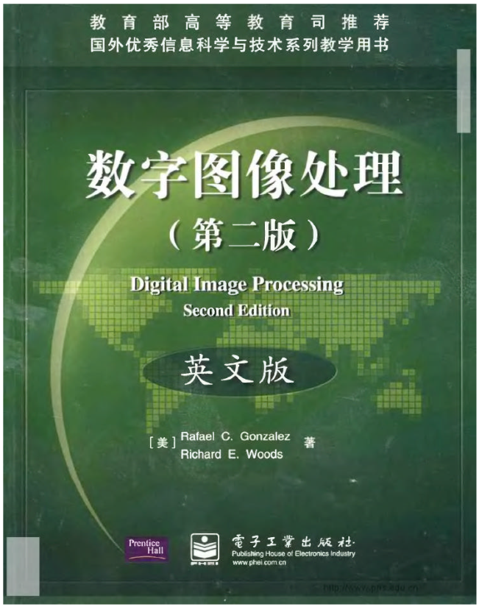
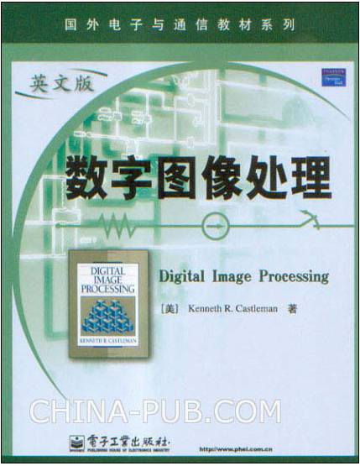
Selected textbook: theory
Digital Image Processing, Second Edition，Rafael C. Gonzalez, Richard E. Woods, Prentice Hall, 2002.
Digital Image Processing, Kenneth R. Castleman, Prentice Hall, 1996.

Slide 3
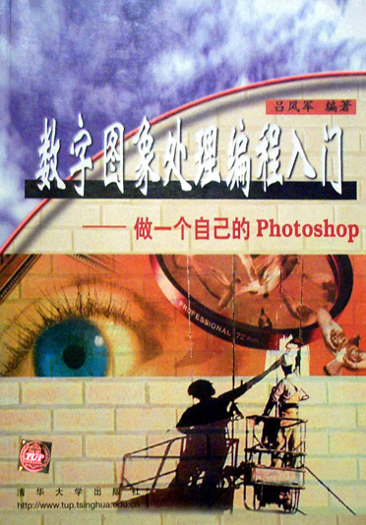
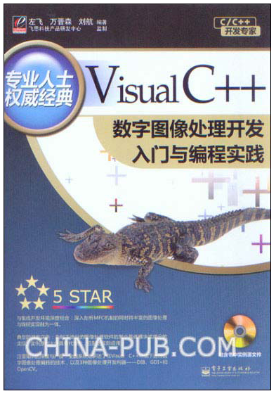
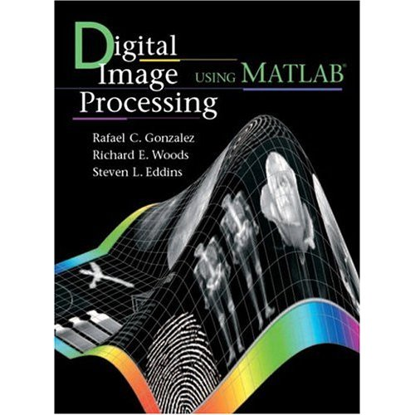
Selected textbook: programing
吕凤军编著，数字图像处理编程入门-做一个自己的Photoshop，清华大学出版社，1999
何军，马天予，王运坚，朱红莲，visual c++ 数字图像处理，人民邮电出版社，2001
R. Gonzalez, R. Woods, S. Eddins, Digital image processing using Matlab, Prentice Hall.
Notes:
但是上面这些书都是多年前出版的，对于该领域的最新发展当然就没有涉及，所用的编程环境也跟现在大家用的有所不同。
为了与时俱进，我们不会严格follow书里面的章节，而是按照自己的需要安排教学内容，尽量自成体系，让大家能有所收获，甚至在这上面有所为。

Slide 4
Importance of digital image
Nowadays, multimedia is everywhere.
As demonstrated by the project “The How Much Information” in University of California, Berkeley, about 1.2 billion hours video was produced in 2002, which is some 70,000 TB, and increasing year by year.
Digital image (or video stream) is the main form to present information.
For human being, more than 60% information are obtained by vision, which is the basis to perceive and understand the surrounding.
Basis of computer vision and computer graphics.
Applications: Computer animation, video surveillance, medical image processing, remote image processing, visual effect & enhancement, etc..
Different forms of imaging
visible, X-ray, Ultrasonic wave, Infrared

Slide 5
What is digital image processing
Image acquisition
Automatic aperture correction and color balance
Image reconstruction
Display and print
Automatic size adjustment
Color correction (CMYK vs. RGB)
Storage and Transmission
High efficient storing: less temporal-spatial cost
Convenient transmission: Lossless, efficient, and secure
Enhancement and restoration
Image restoration：Inpainting
Improve visual effect：dehazing,retinex,deblur,super-resolution
Recognition and understanding
Character recognition：OCR，object detection: face detection
Scene understanding：image retrieval, scene classification

Slide 6
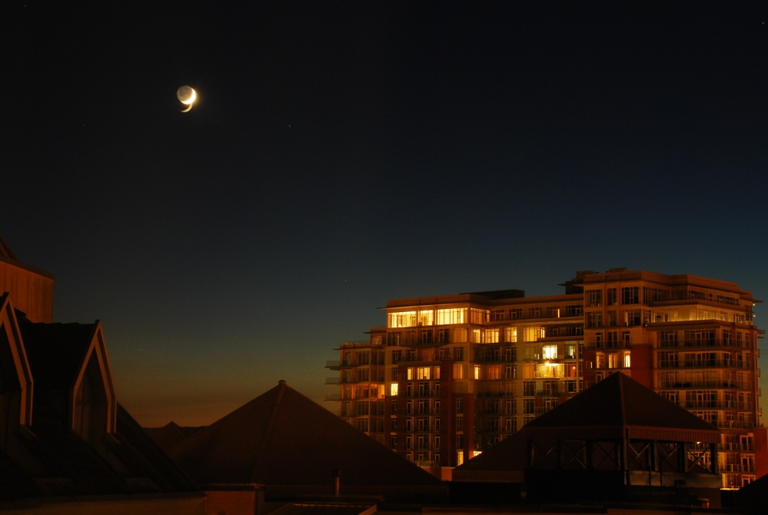

Image acquisition
Automatic aperture correction and color balance
Human eyes can adapt the surrounding luminance dynamically, with very high dynamic range and speed.
照相机适应能力差，反应迟钝
Exposure time:：15s
Exposure time：20s

Slide 7

Image acquisition-cont.
Image stitching：Panaroma

Slide 8
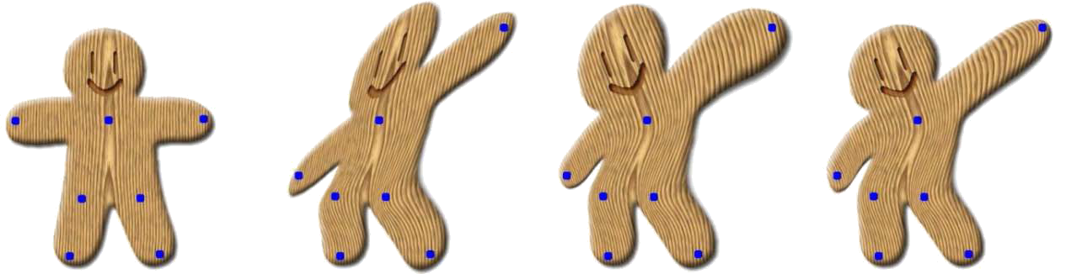
Image acquisition-cont.
Image warping
Original image
Affine transformation
Similarity preserving
Latest method
(Moving least square-SIGGRAPH)

Slide 9
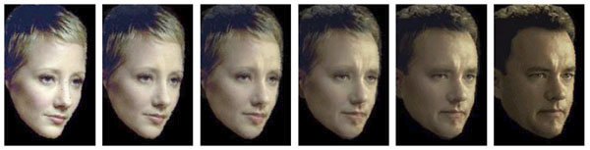
Image acquisition-cont.
Image morphing

Slide 10



Display and print
Automatic size adjustment
Original image
Enlarge directly
Dual cubic interpolation (Less jagged effect)
(Obvious jagged effect)

Slide 11
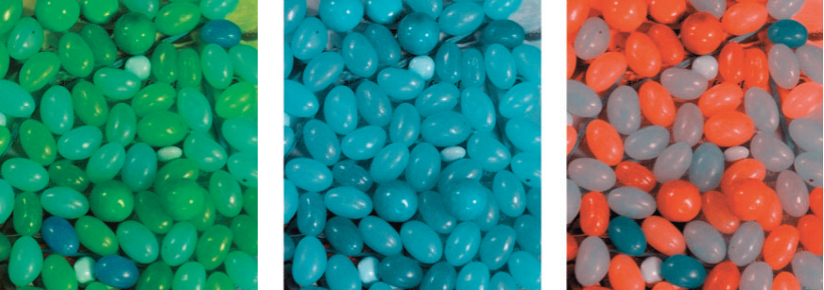
Display and print-cont.
Color correction

Slide 12


Storage and transmission
High efficient storage: less temporal and spatial cost
bmp，492kb
png，407kb
jpeg，23kb
Jpeg is the default format in digital camera

Slide 13
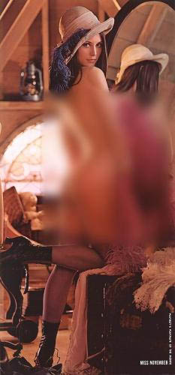

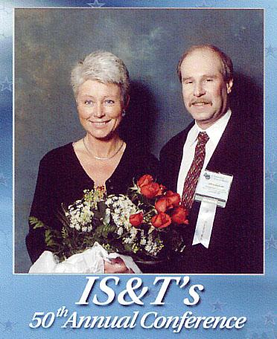
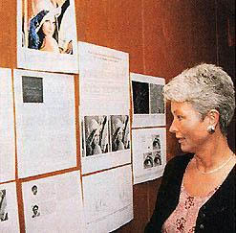
Lena……
1972, playboy
1997, IS&T
Notes:
这是30多年前的故事了。这张图片来源于1972年11月的杂志《PlayBoy》的插页，插页中的人物为瑞典模特Lena Soderberg，而上面这张在数字图像领域广泛使用的图片则是该插页的部分。现在Lena Soderberg 女士居住在她的家乡瑞典，有三个孩子，过着幸福的生活。在1988年的时候，她接受了瑞典一些计算机相关出版社的访问，她对于自己的照片有这样的奇遇感到非常的惊奇与兴奋。这是她第一次知道她的照片被应用在计算机行业。1997年，Lena还被邀请参加了第50届IS&T 会议。
《花花公子》插图怎么会成为图像处理学术界的标准图像呢？ 1973年6月，美国南加州大学的一名教授想找一幅图像来做图像压缩的测试，他已厌倦了手头繁杂的照片，想找张能让人眼前一亮的照片。恰好这时，一人拿着新出的《花花公子》走了进来，Lena的照片确实够让教授眼前一亮了。教授便将《花花公子》的这期插页图用扫描了下来截取其中的一部分作为了他研究使用的样例图像。这位教授就是IPL(图像处理研究所)的 William K. Pratt博士。从此，这幅512X512的经典就诞生了，可以说在图像处理界Lena图像就是学术界的标准。
由于Lena原图有部分身体暴露，上传的图片是经过处理过后的，呵呵！

Slide 14
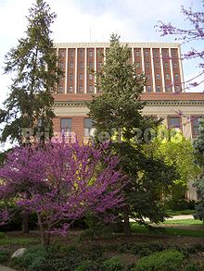
Storage and transmission-cont.
Convenient transmission: lossless, efficient, and secure
Note the watermark
Visible watermark
And, we also have invisible watermark

Slide 15
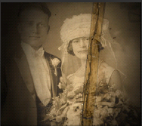
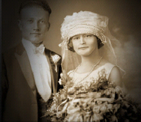
Image enhancement and restoration
Image restoration: Inpainting

Slide 16
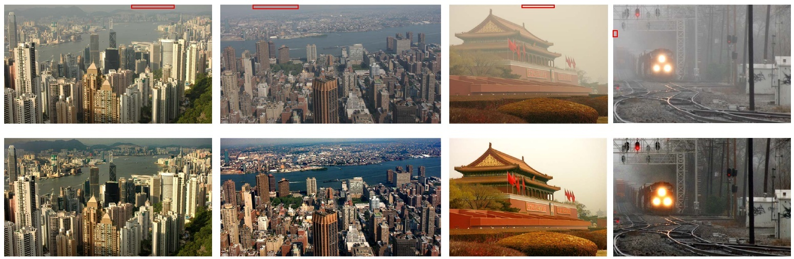
Image enhancement and restoration-cont.
Improving visual effect
dehazing
CVPR 2009 Best Student Paper
Single Image Haze Removal Using Dark Channel Prior

Slide 17
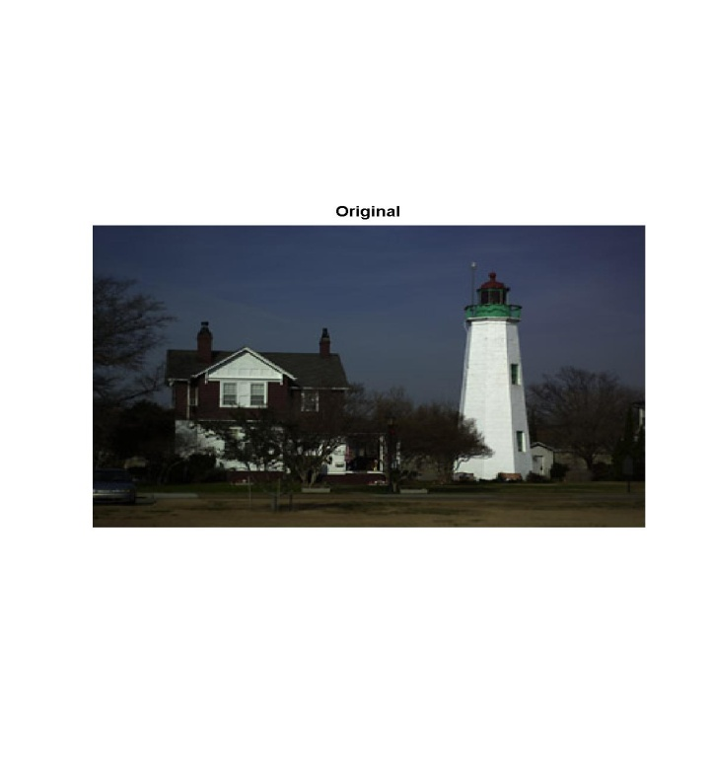
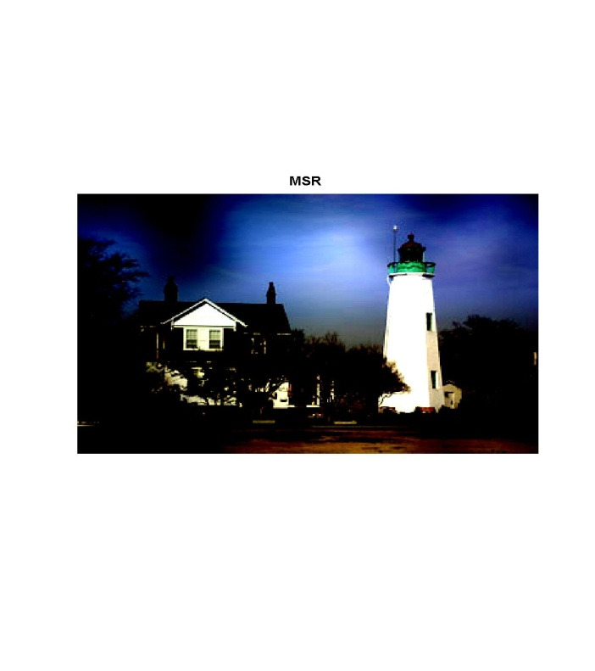
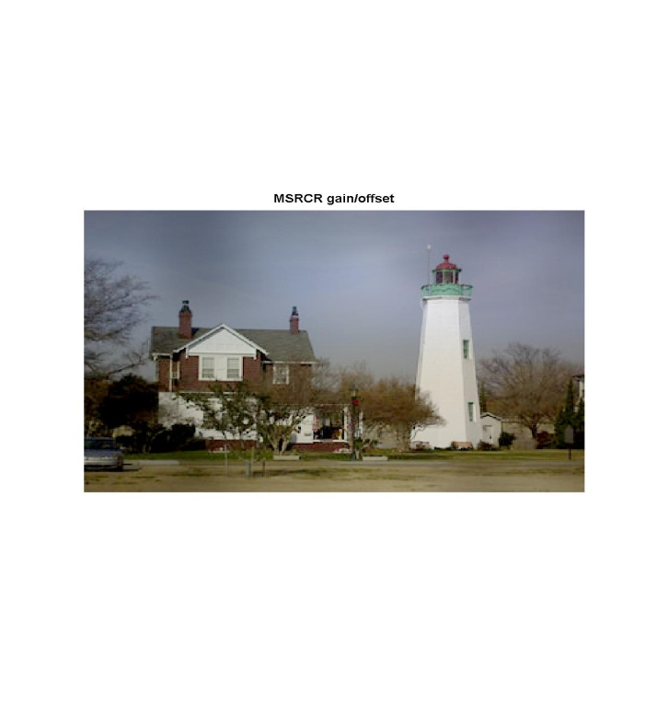
Image enhancement and restoration-cont.
Improving visual effect
retinex

Slide 18
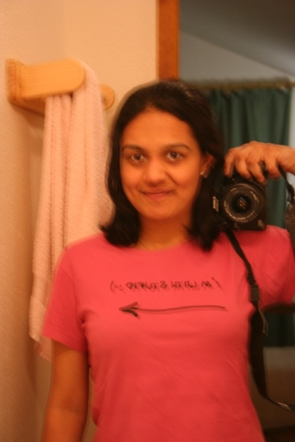
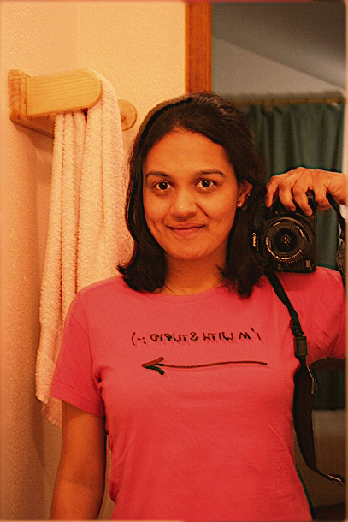
Image enhancement and restoration-cont.
Improving visual effect
deblur
Original
Output
Anat Levin, 2009, TR35
http://www.technologyreview.com/tr35/profile.aspx?trid=810

Slide 19
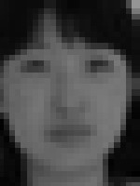
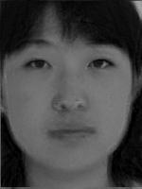
Image enhancement and restoration-cont.
Improving visual effect
super-resolution
Input
Output

Slide 20
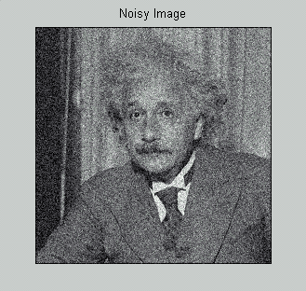
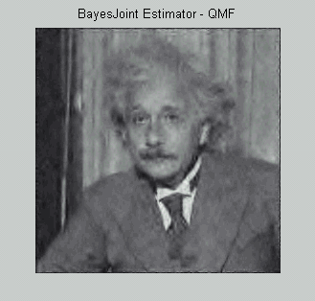
Image enhancement and restoration-cont.
Improving visual effect
de-noise
Input
Output

Slide 21
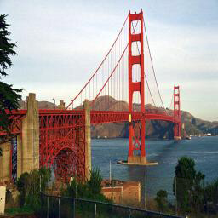
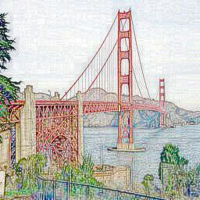
Image enhancment and restoration
Improving visual effect
Stylization
Input
Output

Slide 22
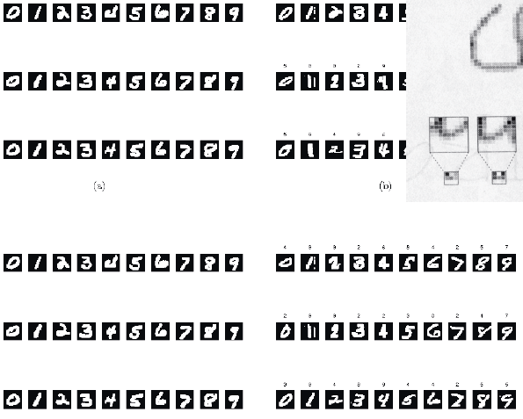
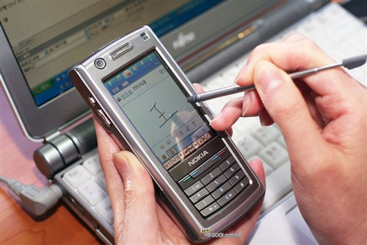
Image recognition and understanding
Character recognition:

Slide 23
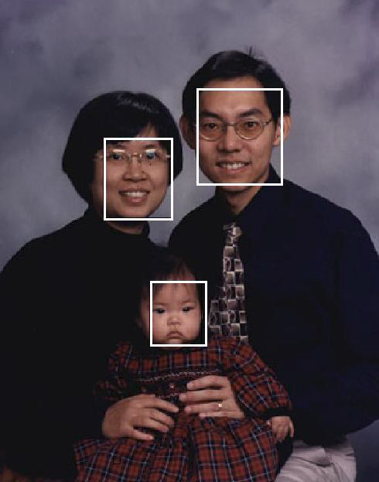
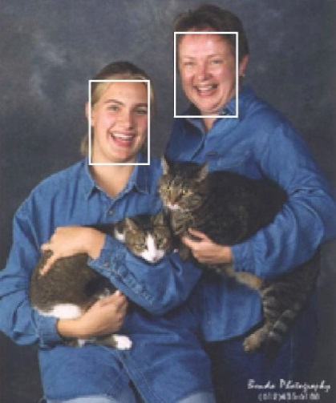
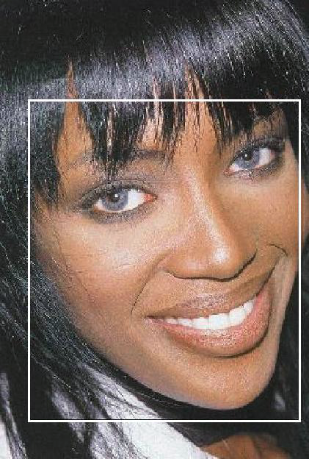
Image recognition and understanding-cont.
Object recognition: face detection

Slide 24
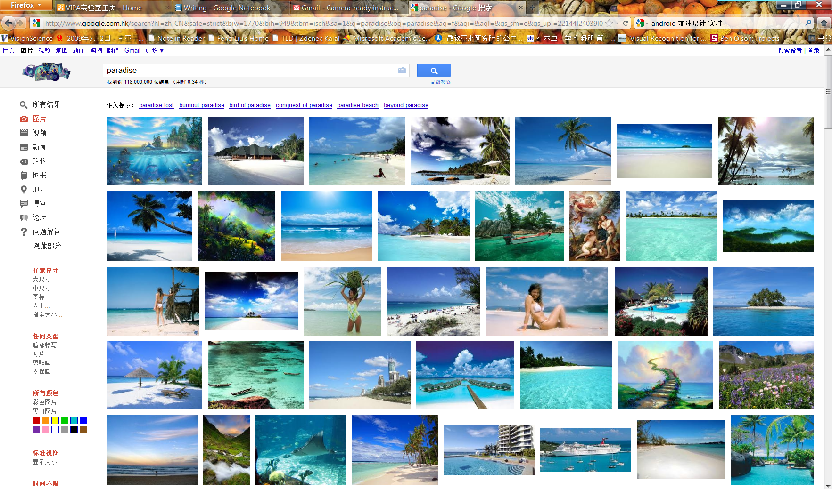
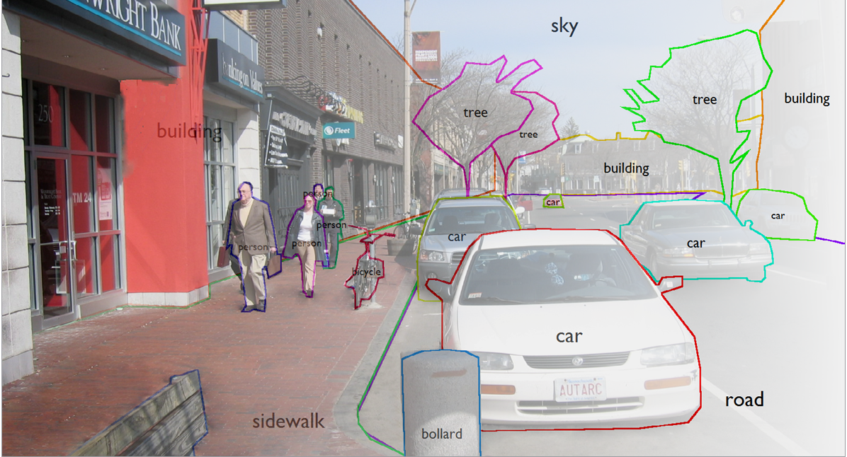
Image recognition and understanding-cont.
Scene understanding: image retrieval, scene classification, etc.

Slide 25
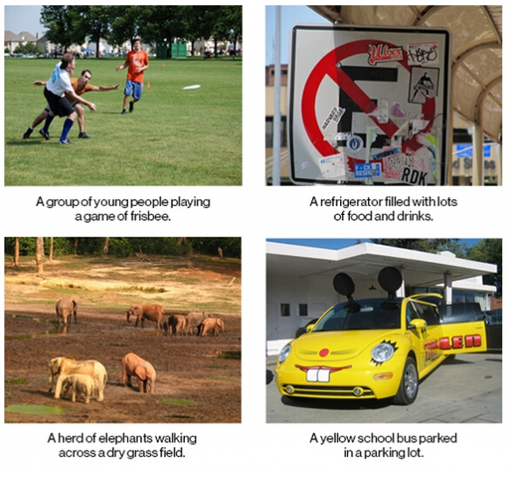
Google图像字幕

Slide 26


Image understanding and understanding-cont.
Interactive image retrieval: Mindfinder

Slide 27
Course schedule: chapter 1
Basic concept and programming introduction
Grayscale image and color image representation
Color space transfer
Image format
Data structure of image: some typical ones
Programming for image processing
An image in computer: array(s)
Image file: its format and read/write
Access DIB: some Windows APIs
An image processing example for VC++
Image processing in Matlab: some typical instructions
Popular image processing softwares

Slide 28
Course schedule: chapter 2
Binary image and morphology
Binary image
How to obtain a binary image: binarization
Image morphological operation
Definition of ‘set’
Erosion
Dilation
‘Open’ operation
‘Close’ operation
Hit-or-miss transform

Slide 29
Course schedule: chapter 3
Basic operations on image (I)
Grayscale image transform
Visibility of image
Visibility enhancement: Logarithm
Histogram of image
Histogram equalization
Etc.

Slide 30
Course schedule: chapter 4
Basic operations on image (II)
Simple geometric transform
Interpolation
Application

Slide 31
Course schedule: chapter 5
Image morphing
Image morphing basic
Static morphing
Dynamic morphing
Feature point based morphing
Grid based morphing

Slide 32
Course schedule: chapter 6
Image convolution
1-D convolution
Property of convolution
Discrete convolution

Slide 33
Course schedule: chapter 7
Image filtering
Smoothing
Sharpening
Bilateral filter
Guided filter (Optional)

Slide 34
Course schedule: chapter 8
Fourier transform
Fourier and his work
Background of Fourier transform
Fourier transform
Discrete Fourier transform (1D)
FFT
FFT in Matlab
2D Fourier transform

Slide 35
Course schedule: chapter 9
Image feature
SIFT
SURF
Deep feature

Slide 36
Course schedule
2 class hours/week*16: lectures
2 class hours/even week*8: experiments
Could be done at home
Course review will be given at the last lesson
Programming language: c/c++

Slide 37
Evaluation
Exam: 60%, close-book exam
Homework: 40%
Plagiarism-->0

Slide 38
Assignment-1
Read a color bmp;
RGB->YUV;
Color to gray: gray=Y in YUV color space;
Rearrange gray intensity to lie between [0,255];
Write a grayscale bmp;
Change the luminance value Y;
YUV->RGB;
Write a color bmp.

Slide 39
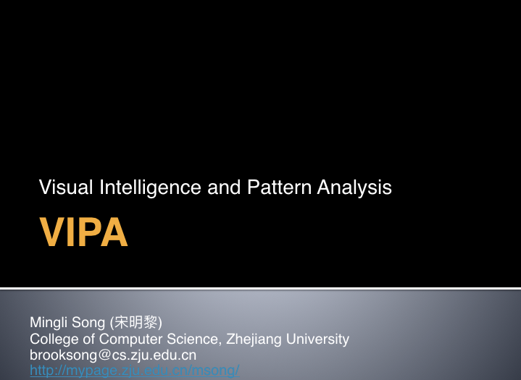
Then,

